Slide 1

Galaxy Studios Comprehensive SQL Database System
Project Presentation by Gokul S
Cleveland State University
IST 634 | Enterprise Database
November 09, 2024

Slide 2

Company Overview
Galaxy Studios Inc. is a film production company specializing in creating high-quality cinematic content across genres. Focuses on pre-production and production.

Slide 3
Project Objectives
Develop a robust database system to support:
Talent Management
Production Details
Financial Tracking
Awards & Recognition
Audience Feedback

Slide 4
Database Design
Designed to support data management across film production stages. Key focus on efficient data retrieval, data integrity, and reducing redundancy (3NF).

Slide 5
Entities
Core entities in the database:
Movie
Actor
Director
Producer
Crew
Awards
Reviewers
Review
Crew Linking (for many-to-many relationships)

Slide 6
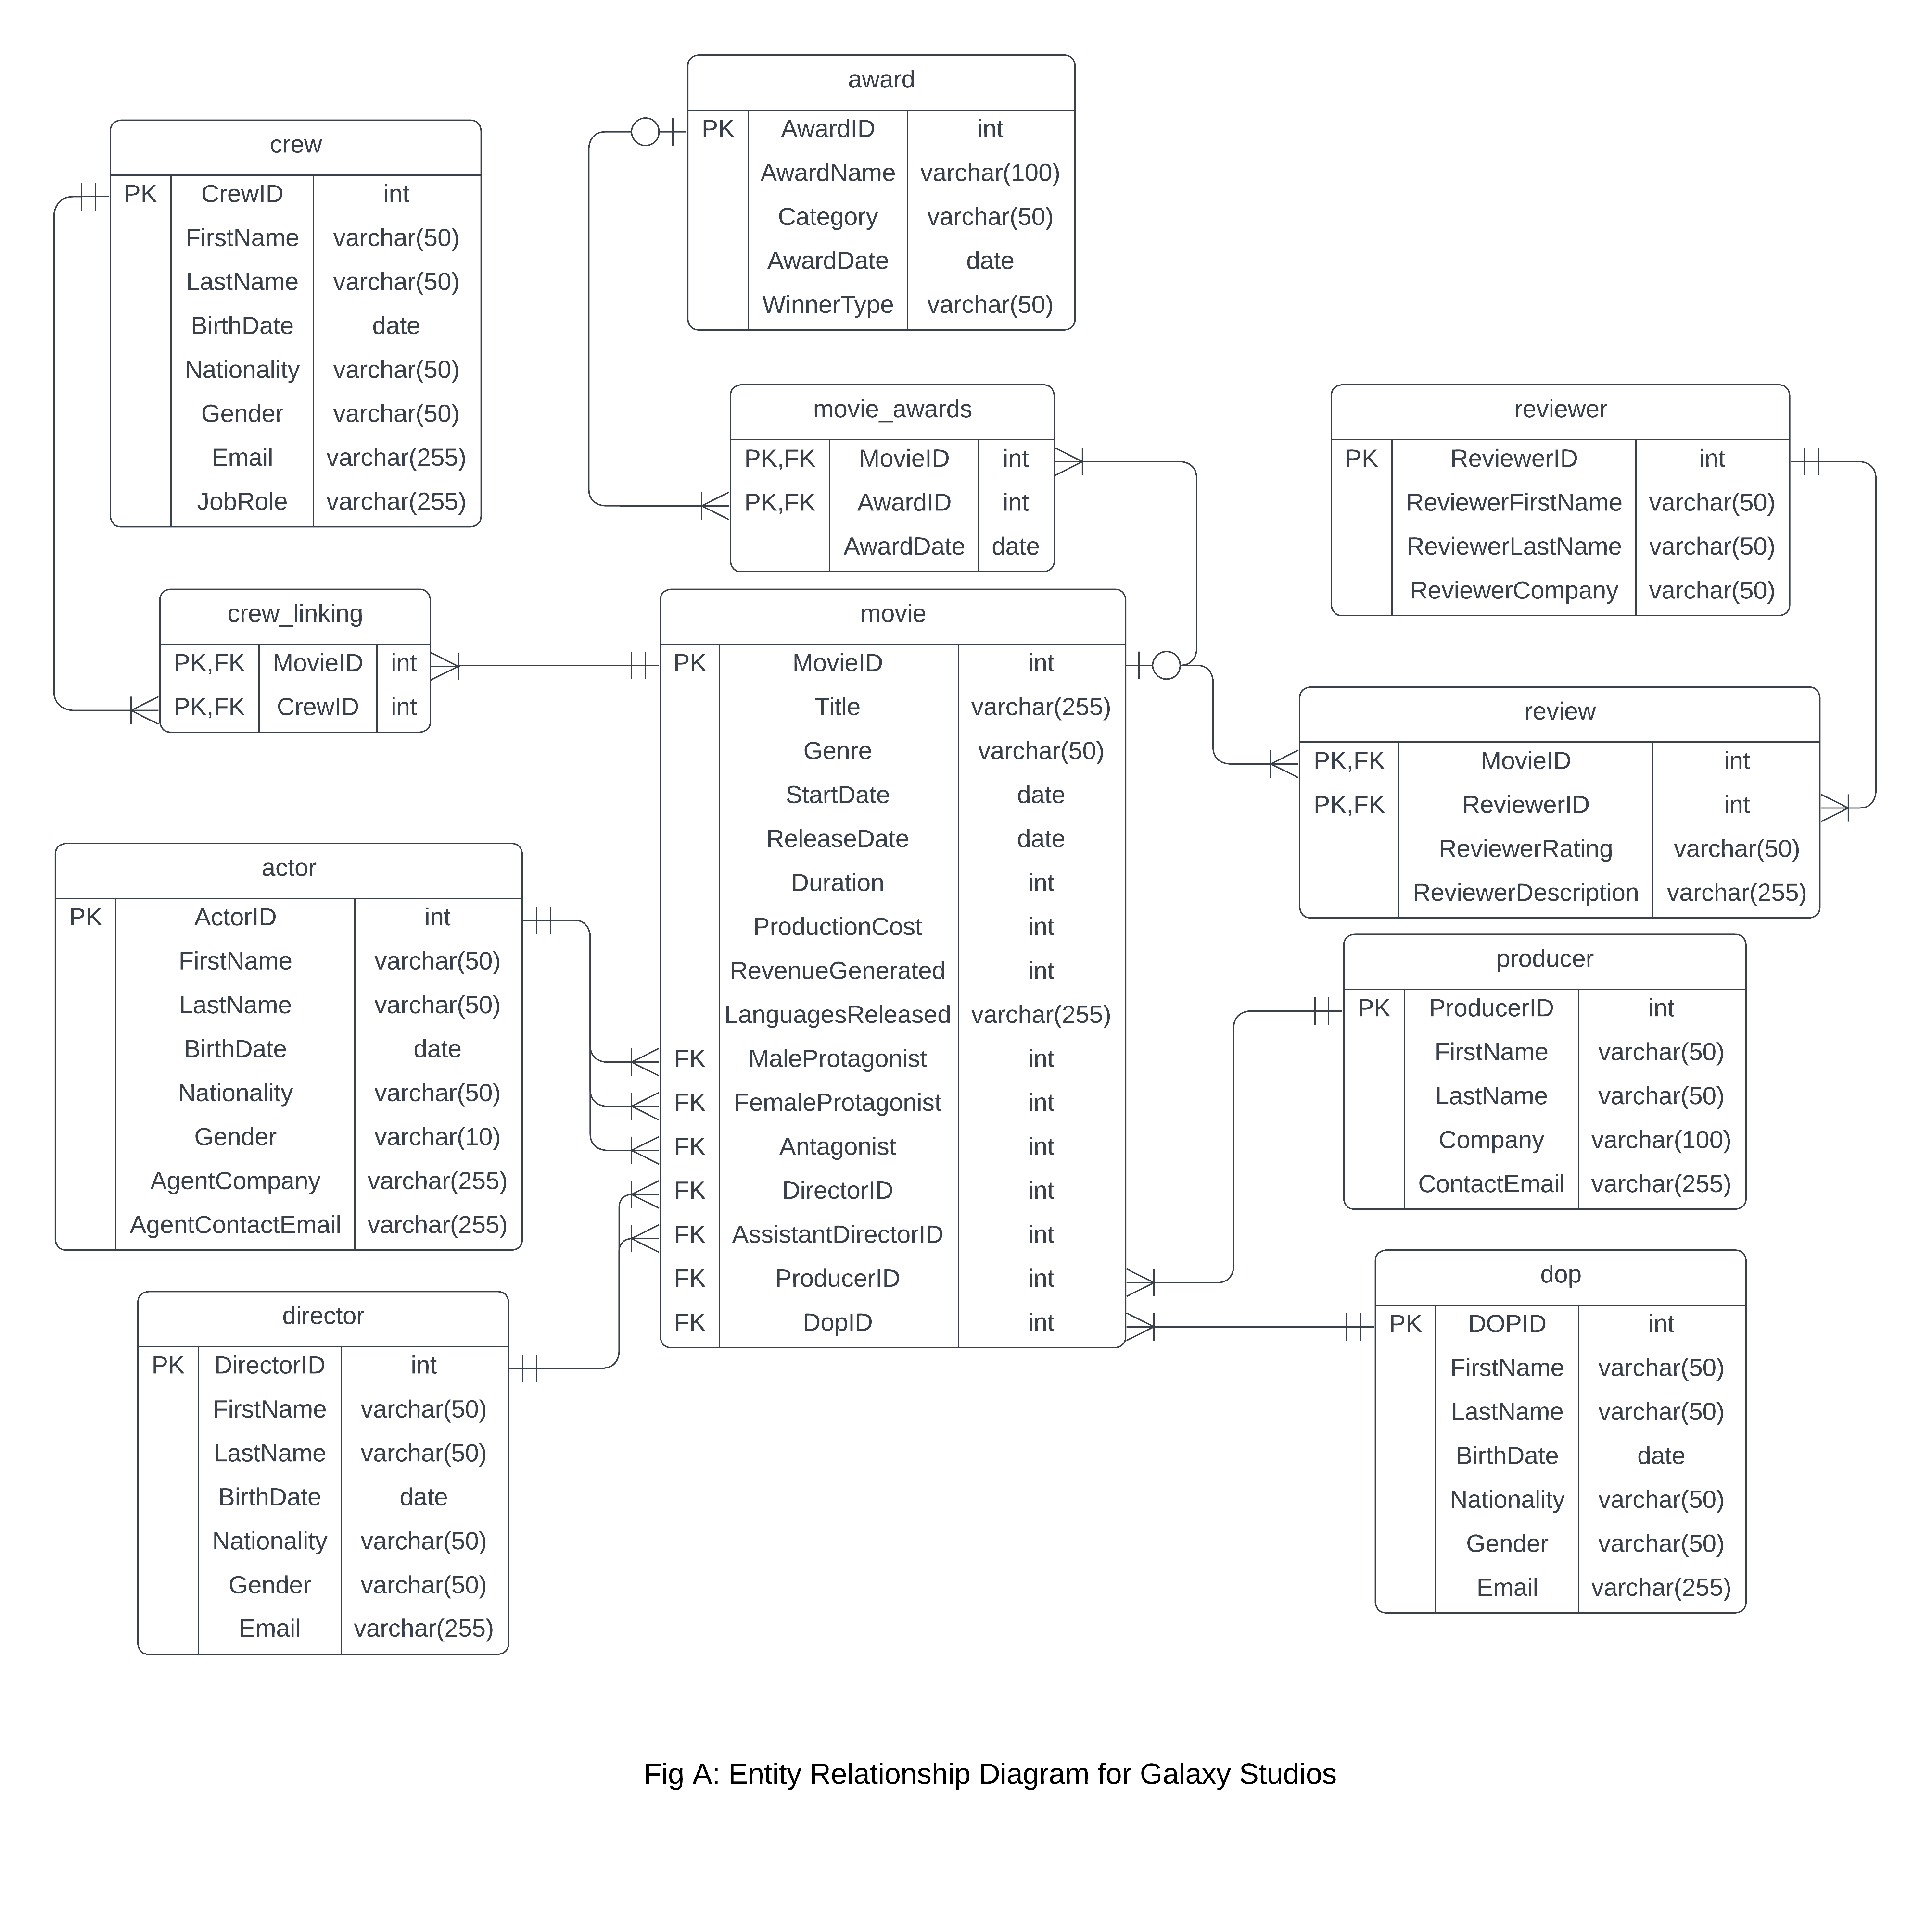
Entity-Relationship (ER) Diagram
Visual representation of relationships among entities. Shows data flow across production stages and dependencies between elements.

Slide 7

Normalization
Applied to achieve 3NF:
1NF - Atomic values
2NF - No partial dependency
3NF - No transitive dependency. Enhances data integrity and minimizes redundancy.

Slide 8

SQL Implementation - Review Table
CREATE TABLE Review (
MovieID INT,
ReviewerID INT,
ReviewerRating varchar(50),
ReviewerDescription varchar(255),
PRIMARY KEY (MovieID, ReviewerID)
);

Slide 9
Sample Data Insertion
INSERT INTO Movie (MovieID, Title, Genre, StartDate, ReleaseDate) VALUES (1, 'Tales of the Deep', 'Western', '2022-08-21', '2023-12-14’);
INSERT INTO Actor (ActorID, FirstName, LastName, BirthDate, Nationality, Gender, AgentCompany,

Slide 10
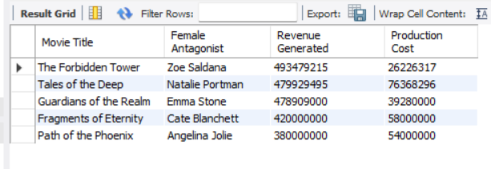
Sample Queries
SELECT
m.Title AS "Movie Title",
CONCAT(a.FirstName, ' ‘, a.LastName) AS "Antagonist Name",
a.Gender AS "Antagonist Gender",
aw.AwardName AS "Award Name",
aw.Category AS "Award Category",
ma.AwardDate AS "Award Date"
FROM
Movie m
JOIN
Actor a ON m.Antagonist = a.ActorID
JOIN
Movie_Awards ma ON m.MovieID = ma.MovieID
JOIN
Award aw ON ma.AwardID = aw.AwardID
WHERE
aw.Category LIKE '%Actor%'

Slide 11
Stored Procedures
Examples:
Update Movie Revenue
Retrieve High-Rated Movies
Insert New Movie Record. Automates routine tasks and ensures consistency.

Slide 12
Triggers
Used for business rules enforcement:
Prevent Negative Revenue
Set Default Award Date
Prevent Duplicate Awards for the Same Movie on the Same Date.

Slide 13
Data Security
User roles:
Admin
Sales Manager
Inventory Manager
Reviewer
Analyst. Provides controlled access and protects sensitive data.

Slide 14
Backup Strategy
Includes:
Full Backup (weekly)
Differential Backup (daily)
Transaction Log Backup (hourly). Stored on-site and off-site for disaster recovery.

Slide 15
Conclusion & Demonstration
Galaxy Studios’ SQL Database System streamlines data management, supports operational goals, and provides analytics. A brief demonstration will follow.

